Slide 1


Enhancing Mars Helicopter Performance with Tethered Flight and Active Flow Controls
By: Jasmine Garnett
Mentor: Dr. Sergey Shkarayev

Slide 2
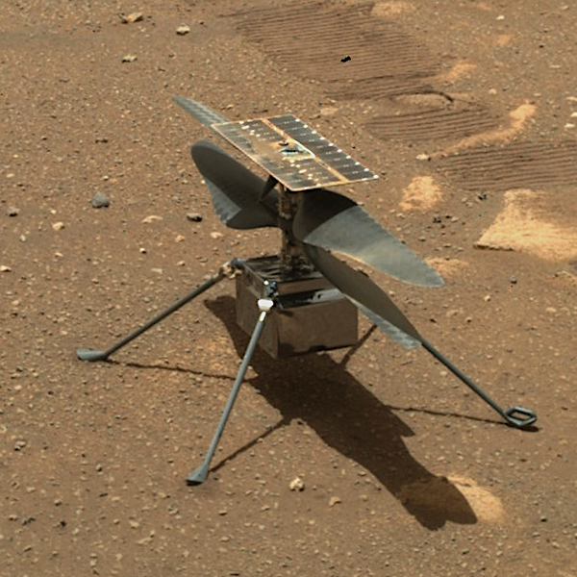
Background - The Ingenuity Mars Helicopter (IMH)
A helicopter built by NASA to collect data to understand how flight can be accomplished on another planet
Completed 72 Missions between April 2021-January 2024
Recorded video of its flight path and of the surface of Mars
The original design consisted of 2 sets of wings angled at 8.2° and 9.2°
Eventually broke apart

Slide 3
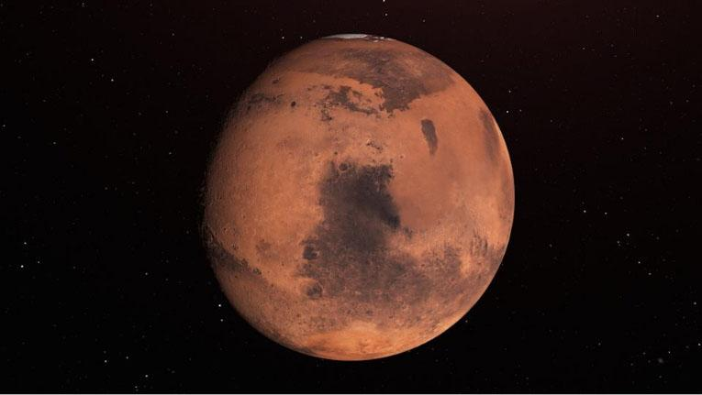
Research Objective
For future human exploration on the planet
To be informed of Mars and its atmosphere, surface, any potential threats
For future designs of vehicles, both land and air, to be able to withstand any condition on Mars to produce flight
To understand how the design of this helicopter can be improved if it were to be rebuilt

Slide 4
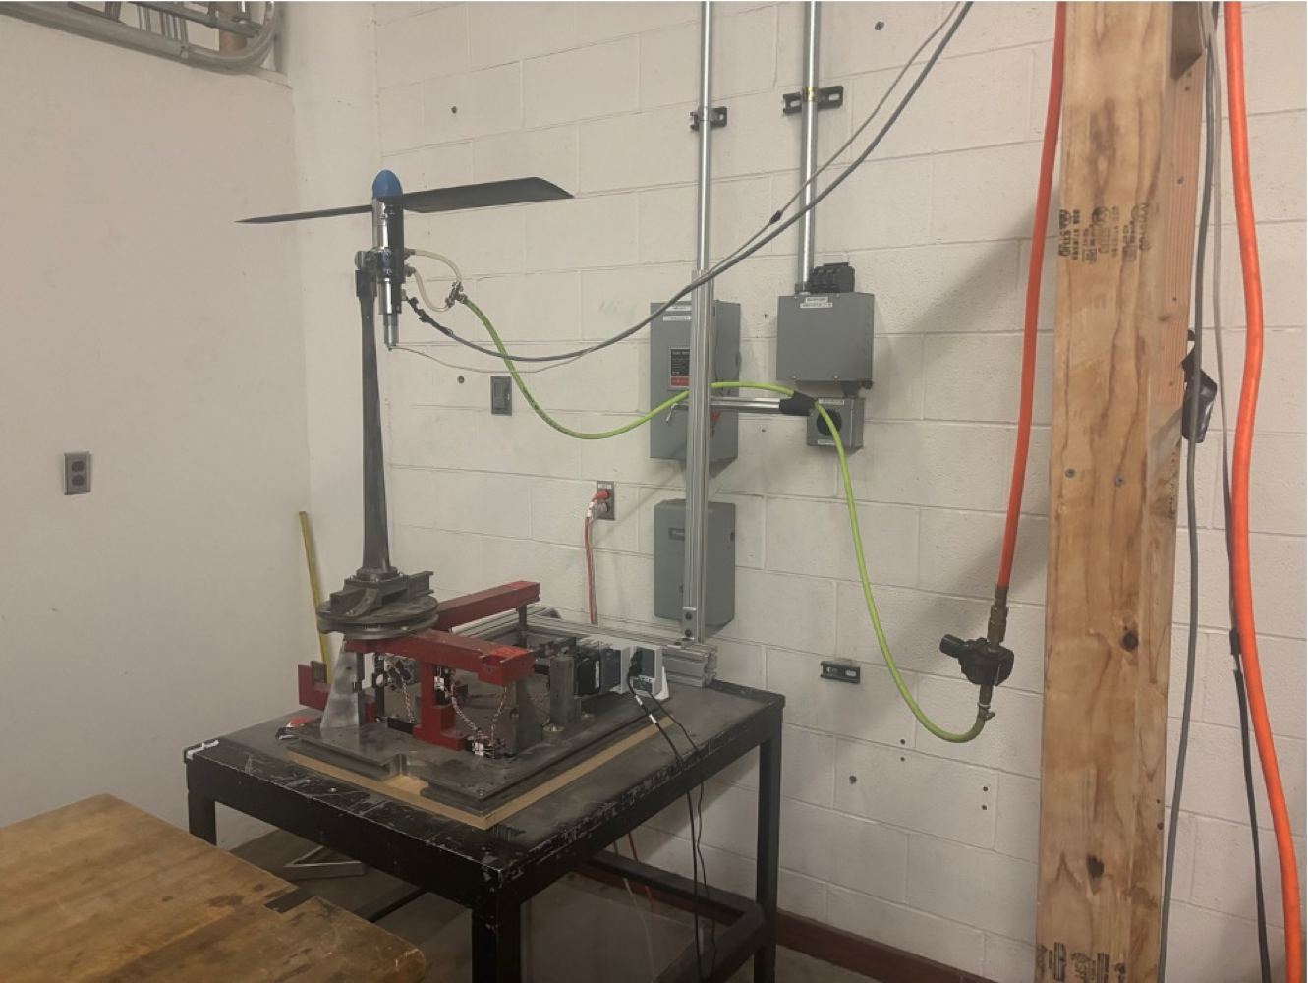
The Experimental Setup
Wing Blades
2
1
Air Supply Tube
Rotor
Pylon
Balance
PSI Gauge
Slab of Wood

Slide 5
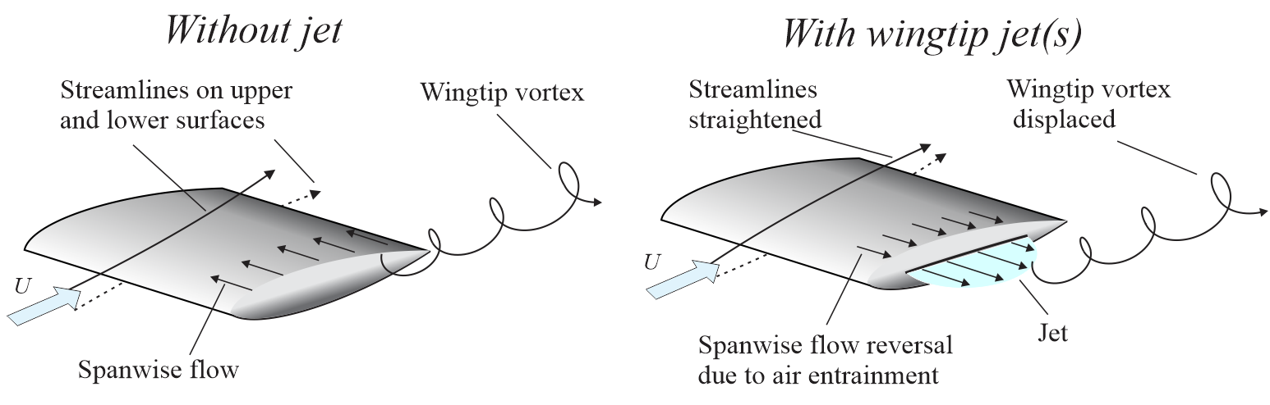
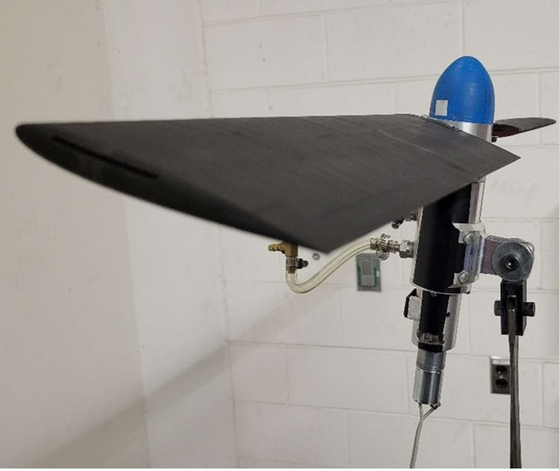
The Blades – In Detail

Slide 6
The Balance – Up Close
F4
F5
The balance helps us understand how the blades are being affected by the air supply
The balance contains strain gauges
Forces are read from the square gauges
Moments are read from the circular gauges
Coordinate Axes are X, Y, and Z
x
F3
y
F6
F1
F2
z

Slide 7
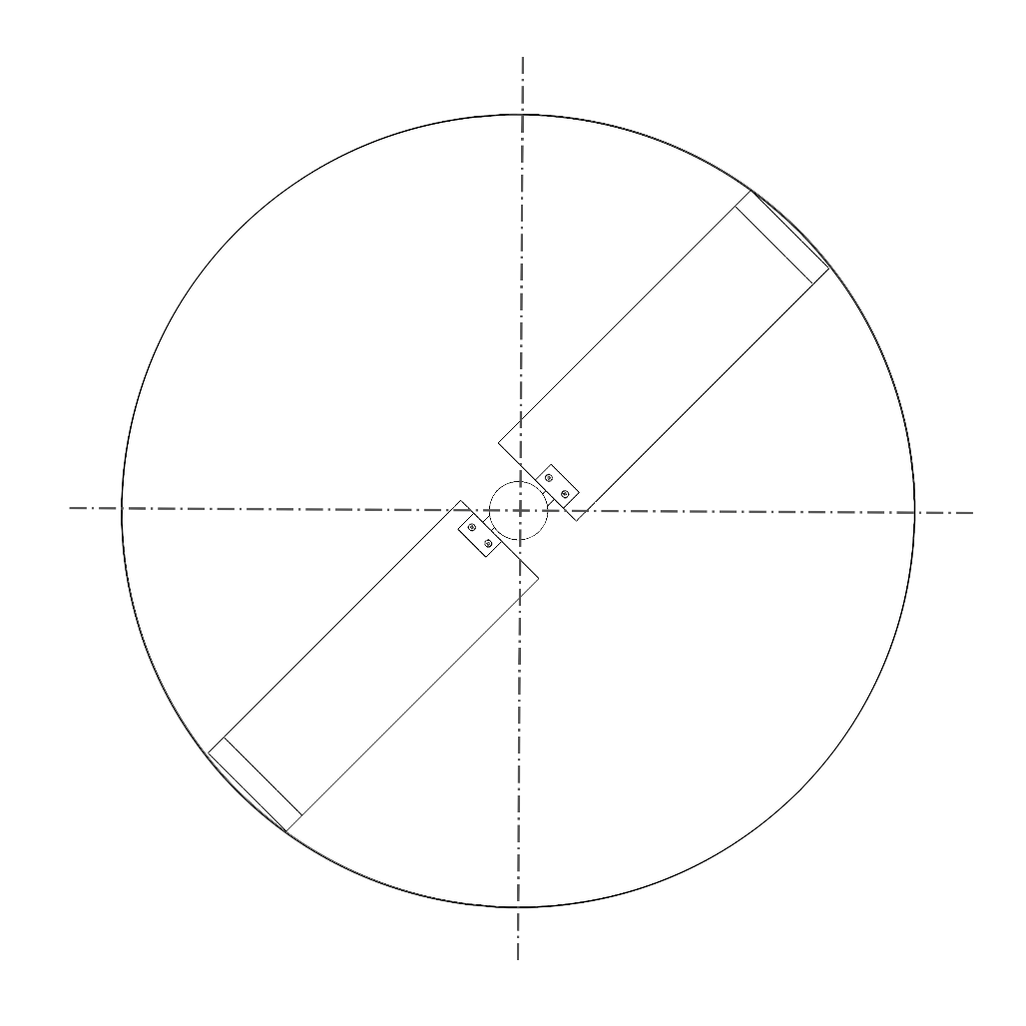






Experimental Materials & Specifications
Wooden Protective Board
Power Supply
at 300 RPM
Air Supply
Varying from 0-55 PSI
Angle of Attack of 8° and 10°
5 trials conducted for each PSI level
Example: 5 trials conducted for 15 PSI
Initial Blade 1 position of ѱ=90° or perpendicular to the wooden protective board
In other words, position Blade 1 begins at start of the experiments
$$ψ={90}^{∘}$$
$$Blade 1$$
$$ψ={180}^{∘}$$
$$ψ=0^{∘}$$
$$Blade 2$$
$$ψ={270}^{∘}$$

Slide 8
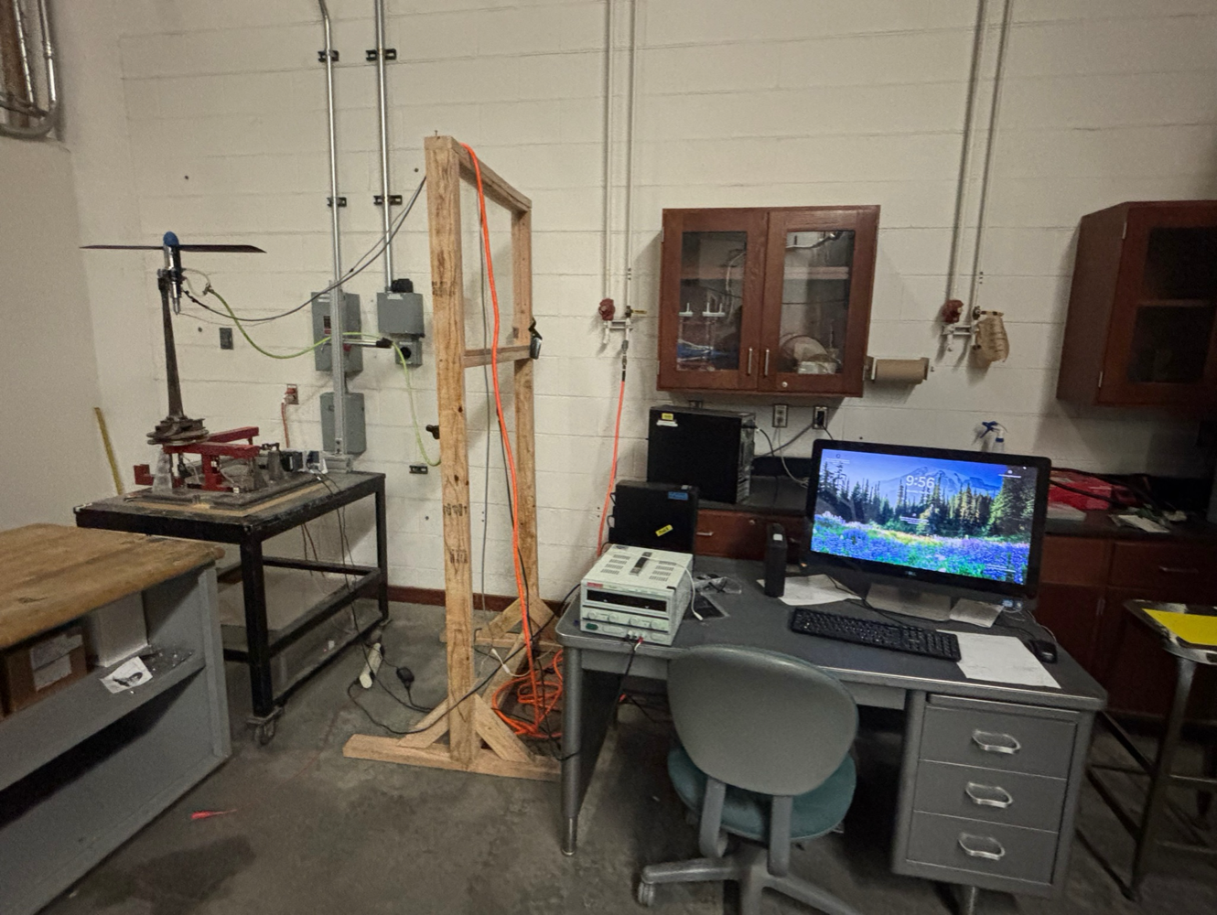
Experimental Procedure & Setup
Air Supply
Lab Computer
Wooden Protective Board
Power Supply

Slide 9
Comparisons Between Force Data for 8° and 10°

Slide 10
Observations
The data for Fx and Fy for 8° are slightly closer to zero compared to the 10° data
Yet, data for 10° is more consistent with one another and the values fluctuate less
Note – Fx values are primarily negative and closer to zero – Fy values are primarily positive and close to zero
This indicates that the airstream is providing a positive force in the y direction and a negative force in the x direction
When comparing thrust values, it is evident that 10° data is better than 8° data due to values being non-zero and positive
The data for 8° is inconsistent when considering that there must be thrust from power supply and airstream tip jets that are providing additional thrust onto the blades

Slide 11
Comparisons Between Moment Data for 8° and 10°

Slide 12
Observations
Overall, data between each angle of attack value resides in negative regions of graphs. This indicates the air supply is creating a negative bending moment onto the blades
This negative bending moment results in there being compression at the bottom of the blades and tension on top
For an angle of attack of 10°, this is most prevalent where the values are more negative with the difference between the 8° and 10° data being about -0.015 Newton Meters
In summary, if these blades were a part of an actual helicopter, it would result in more lift being created

Slide 13
Conclusions
Having tip jets provides more stability for the blades as well as providing potentially better performance
Increases negative bending moment
Between 30-40 PSI is the most ideal air pressure to keep the blades from stalling and, therefore, failing to create further lift
Having a 10° angle of attack is better
Having a more negative bending moment compared to the 8° data which has a slightly more positive one, would create more lift which could help the overall flight of future helicopters created

Slide 14
Future Research
Testing different wing and rotor setups to determine what other factors could influence the forces and moments experienced by the blades
Experimenting with different angles of attack of the blades
Experimenting with multiple blade models situated above/below one another to understand how the blades operate in relation to each other
Using Variable Speed Wind Tunnels
To understand how the blades would be affected by inclement weather and debris
Would simulate the atmosphere and weather on Mars

Slide 15
THANK YOU
UA Space Grant
Mentor: Dr. Sergey Shkarayev
Graduate and PhD Student Lab Colleagues:
Parisa Footohi, Adrien Bouskela, Colby Thomas, Adam Nekolny

